Slide 1


Truth & Logic
“Truth is like the sun. You can shut it out for a time, but it ain’t goin’ away.”
– Elvis Presley

Slide 2
Truth: It’s Not Fake
Logical comparisons can be used to determine truth values via propositional logic.
A proposition is either true or false – nothing more, nothing less!
I am a stegosaurus. (false)
You can get free shoes in Tallahassee. (true)
10 > 9000 (false)
i^{i} is a real number (true)
What time is it? (question)
Marston is better than West. (opinion… but true.)
We can represent individual propositions using identifiers (variables).

Slide 3
Compound Propositions
We can build compound propositions using connectives.
Name | Symbol | In English
Conjunction | A ∧ B | A and B
Disjunction | A ∨ B | A or B
Exclusive-Or | A ⊕ B | A or B (not both)
Negation | ¬ A | not A
Implication | A → B | A implies B
Biconditional | A ↔ B | A if and only if B
Variable | Meaning | T/F
STEG | I am a stegosaurus. | F
GREEN | All gators are green. | F
FSU | Players get free shoes in Tallahassee. | T
WAT | i^{i} is a real number. | T
SWAMP | There are more than 9000 memes!!! | T
Expression | Meaning | Truth | T/F
GREEN ∨ FSU | All gators are green OR players get free shoes in Tallahassee. | F ∨ T (F OR T) | T
SWAMP ∧ WAT | There are more than 9000 memes AND i^{i} is a real number. | T ∧ F (T AND F) | F
¬ STEG | It is NOT true that I am a stegosaurus. | ¬ F (NOT F) | T

Slide 4
Implication: It’s Complicated
We often read implication as “if A, then B.” But this can be misleading…
“The world is flat implies zombies will take over.” ⬅ THIS IS TRUE!
…But why?
If the premise is false, the implication is always true
The consequence only matters with a true premise
This makes an, so implication is more like a promise:
“If you give me a sandwich, then I will be your friend.”
If you don’t give me a sandwich, I might still be your friend. It’s only false if I break the promise!
A Biconditional is similar, but the conditional goes both ways:
“I’ll be your friend if and only if you give me a sandwich.”
If the biconditional is true - if I’m your friend, you must have given me a sandwich!

Slide 5
Truth Tables
Logical connectives can be confusing; we describe them explicitly with truth tables.
¬A = C
A | C
T | F
F | T
A ∧ B = C
A | B | C
T | T | T
F | T | F
T | F | F
F | F | F
A ∨ B = C
A | B | C
T | T | T
F | T | T
T | F | T
F | F | F
A ⊕ B = C
A | B | C
T | T | F
F | T | T
T | F | T
F | F | F
A → B = C
A | B | C
T | T | T
F | T | T
T | F | F
F | F | T
A ↔ B = C
A | B | C
T | T | T
F | T | F
T | F | F
F | F | T

Slide 6
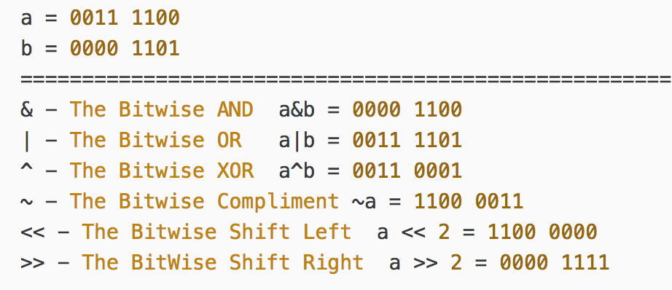
Bitwise operations
Are very easy, probably the easiest thing you will see in your life. Lets look at some examples:
Overview:

Slide 7
Bitwise Operator & - AND
The & bitwise operator tests for both bits to be a 1/true/on.
a = 0011 1100 b = 0000 1101
Compute vertically with each column: a&b
Result is: 0000 1100

Slide 8
Bitwise Operator | - OR
The | bitwise operator tests for either bit (or both bits) to be a 1/true/on.
a = 0011 1100 b = 0000 1101
Compute vertically with each column: a|b
Result is: 0011 1101

Slide 9
Bitwise Operator ^ - XOR
The ^ XOR operator is the most foreign of the group. It simply tests for opposite pairs.
a = 0011 1100 b = 0000 1101
Compute vertically with each column: a^b
Result is: 0011 0001
1st & 2nd column contain the same, 3rd & 4th contain one of each, 5th, 6th & 7th the same, 8th one of each.

Slide 10
Bitwise Operator ~ Compliment
The ~ bitwise operator is the easiest, it just inverts/flips each bit
a = 0011 1100
~a result is: 1100 0011

Slide 11
Bitwise Operator << Shift Left
The << left shift operator pushes the bits to the left by the specified number
a = 1011 1101
a << 2 will shift the bits 2 places to the left
Result is 1111 0100

Slide 12
Bitwise Operator >> Shift Right
The >> right shift operator pushes the bits to the right by the specified number
a = 1011 1101
a >> 2 will shift the bits 2 places to the right
Result is 0010 1111

